Slide 1
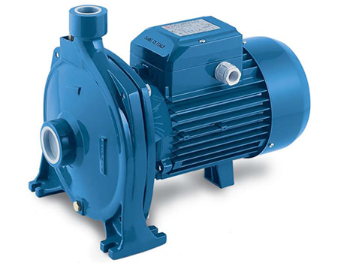
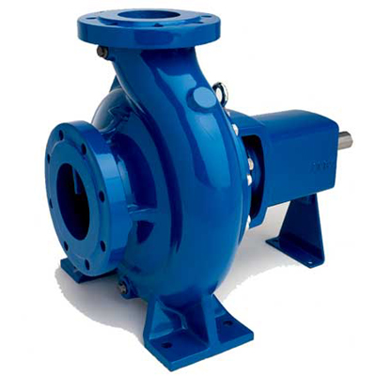
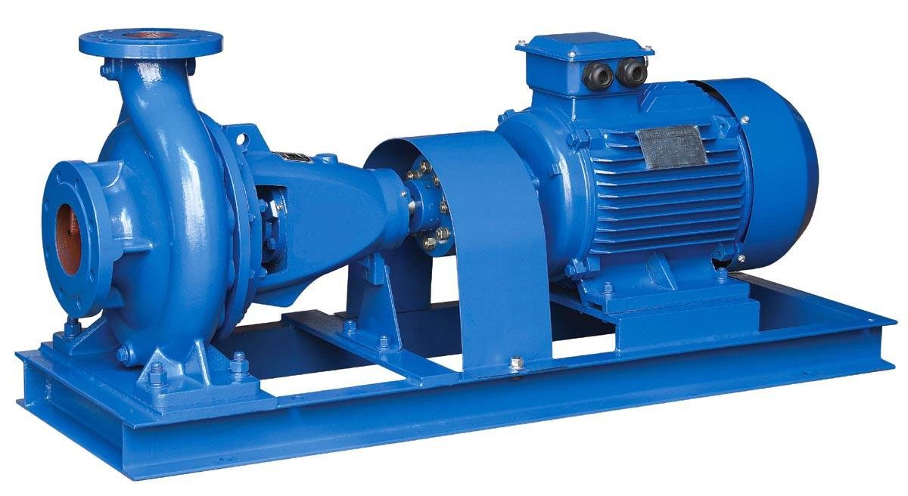
Fluid Flow
Pumps

Slide 2
Introduction
Pumps are devices for supplying energy or head to a flowing liquid in order to overcome head losses due to friction or to raise liquid to a higher level.
Examples for the use of pumps in the process industries
pumping of petroleum products from bulk store to process buildings
pumping of fluids to the reaction units
pumping of fluids through heat exchangers
Fundamental parameters
The mass flow rate of fluid through the pump, for incompressible flow, it is more common to use volume flow rate rather than mass flow rate.
net head H, defined as the change in Bernoulli head between the inlet and outlet of the pump
$$\frac{p_{in}}{ρg} + \frac{{{u_{in}^{2}}^{ }}_{ }}{2g}+z_{in}+H_{pump}=\frac{p_{out}}{ρg} + \frac{u_{out}^{2}}{2g}+z_{out}$$
$$H_{pump}={\left(\frac{p_{ }}{ρg} + \frac{u_{ }^{2}}{2g}+z_{ }\right)}_{out}−{\left(\frac{p_{ }}{ρg} + \frac{u_{ }^{2}}{2g}+z_{ }\right)}_{in}$$

Slide 3
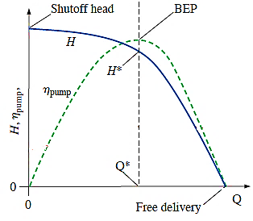
$${\dot{W}}_{pump}=\dot{m}gH=QρgH$$
$$η_{pump}=\frac{\dot{Mech. energy increase of the fluid({\dot{W}}_{pump})}}{\dot{W_{supplied }}}=\frac{ρgHQ}{\dot{W_{supplied }}}$$
Pump Performance Curves and Matching a Pump to a Piping System
free delivery : Q= max H = 0, its achieved when there is no flow restriction at the pump inlet or outlet, in other words when there is no load on the pump. At this operating point, efficiency is zero because the pump is doing no useful work Eq. 2. At
shutoff head H is = max Q = 0, its achieved when the outlet port of the pump is blocked off. Under these conditions,; the pump’s efficiency (Eq. 2) is again zero, because the pump is doing no useful work.

Slide 4
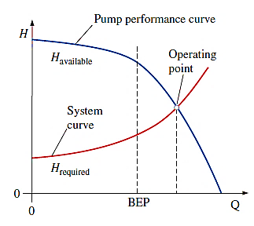
Between these two extremes, from shutoff to free delivery, the pump’s net head is occurring
It is important to realize that for steady conditions, a pump can operate only along its performance curve.
Thus, the operating point of a piping system is determined by matching system requirements (required net head) to pump performance (available net head).
In a typical application, H_{required} and H_{available} match at one unique value of flow rate, this is the operating point or duty point of the system.
The volume flow rate of a piping system is established where H_{required} = H_{available}.

Slide 5
The most common situation is that an engineer selects a pump that is somewhat higher than actually required. The volume flow rate through the piping system is then a bit larger than needed, and a valve is installed in the line so that the flow rate can be decreased as necessary.

Slide 6
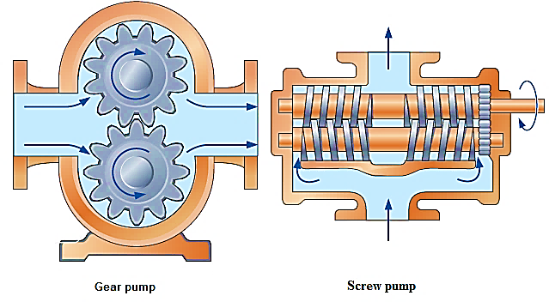
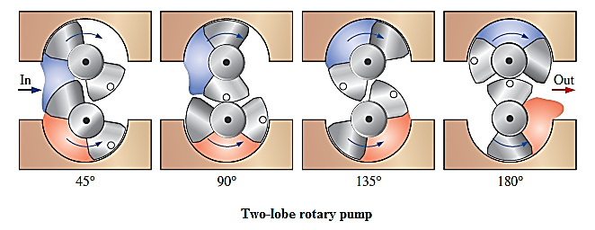
Types of Pumps
Pumps can be classified into: -
Positive displacement pumps. 2- Dynamic Pumps
1-Positive-Displacement Pumps
People have designed numerous positive-displacement pumps throughout the centuries, like:
The piston Pump
The Gear Pump
The Cam Pump
The Screw pumps
Rotary pump

Slide 7
Properties
These pumps are ideal for high-pressure
and where precise amounts of liquid are to be dispensed or metered, as in medical applications.
Fluid can leak through these gaps, reducing the pump’s efficiency. High viscosity fluids cannot penetrate the gaps as easily; hence the net head (and efficiency) of a rotary pump generally increases with fluid viscosity.
They are used, for example, as automobile engine oil pumps and in the foods industry to pump heavy liquids like syrup, tomato paste, and chocolate, and slurries like soups.

Slide 8
Positive-displacement pumps have many advantages over dynamic pumps.
For example:
A positive-displacement pump is better in handling shear sensitive liquids, this is one reason why positive-displacement pumps are used for artificial hearts.
A well-sealed positive-displacement pump can create a significant vacuum pressure at its inlet. We refer to this kind of pump as a self-priming pump
The rotor(s) of a positive- displacement pump run at lower speeds than the rotor (impeller) of a dynamic pump at similar loads, extending the useful lifetime of seals, etc.
There are some disadvantages of positive-displacement pumps
Their volume flow rate cannot be changed unless the rotation rate is changed. As most AC
They create very high pressure at the outlet side, and if the outlet becomes blocked, ruptures may occur or electric motors may overheat. (e.g., a pressure-relief valve) Because of their design,
positive-displacement pumps sometimes deliver a pulsating flow, which may be unacceptable for some applications.

Slide 9
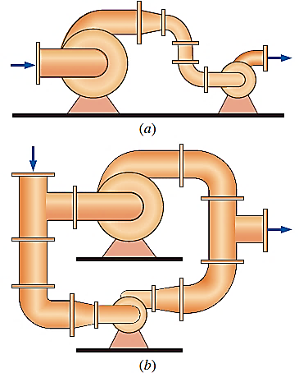
Pumps in Series and Parallel
Arranging dissimilar pumps in series Fig (a) may create problems because the volume flow rate through each pump must be the same, but the overall pressure rise is equal to the pressure rise of one pump plus that of the other. If the pumps have widely different performance curves, the smaller pump may be forced to operate beyond its free delivery
$$Combined net head for n pumps in series: H_{combined}=\sum_{i=1}^{n}{H_{i}}$$
Arranging dissimilar pumps in parallel Fig (b) may create problems because the overall pressure rise must be the same, but the net volume flow rate is the sum of that through each branch.
and the flow in its branch could actually be reversed
$$Combined capacity for n pumps in parallel: Q_{combined}=\sum_{i=1}^{n}{Q_{i}}$$

Slide 10
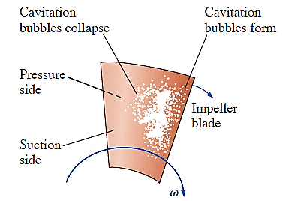
Pump Cavitation and Net Positive Suction Head
When P < P_{v}, vapor-filled bubbles called cavitation bubbles appear. typically on the suction side of the rotating impeller blades where the pressure is lowest. After the cavitation bubbles are formed, they are transported through the pump to regions where the pressure is higher, causing rapid collapse of the bubbles
It causes noise, vibration, reduced efficiency, and most importantly, damage to the impeller blades. Repeated bubble collapse near a blade surface leads to pitting or erosion of the blade and cause blade failure.
It is useful to employ a flow parameter called net positive suction head (NPSH), defined as the difference between the pump’s inlet stagnation pressure head and the vapor pressure head,
$$NPSH={\left(stagnation pressure\right)}_{pump inlet}−\frac{{p_{v}}_{ }}{ρg}$$
$$NPSH={\left(\frac{p_{ }}{ρg}+\frac{{{u_{ }^{2}}^{ }}_{ }}{2g}\right)}_{pump inlet}−\frac{{p_{v}}_{ }}{ρg}$$
Pump manufacturers test their pumps for cavitation in a pump test facility, the pump manufacturer then publishes a performance parameter called the required net positive suction head (NPSH_{required}),

Slide 11
$$\underset{⇒}{Example 1/(iii):}$$ Applying Bernoulli equation between (suction point) and the (pump inlet point) we get: $$\frac{p_{suction P.}}{ρg} + \frac{{{u_{suction P.}^{2}}^{ }}_{ }}{2g}+z_{suction P.} =\frac{p_{pump inlet}}{ρg} + \frac{u_{pump inlet}^{2}}{2g}+z_{pump inlet}+h_{L}$$ $${\left(stagnation pressure\right)}_{pump inlet}=\left(\frac{p_{pump inlet}}{ρg} + \frac{u_{pump inlet}^{2}}{2g}\right)$$ $$=\frac{p_{suction P.}}{ρg} + \frac{{{u_{suction P.}^{2}}^{ }}_{ }}{2g}+\left(z_{suction P.}−z_{pump inlet}\right)−h_{L}$$ $$NPSH={\left(stagnation pressure\right)}_{pump inlet}−\frac{{p_{v}}_{ }}{ρg}$$ $$NPSH=\left(\frac{p_{suction P.}}{ρg} + \frac{{{u_{suction P.}^{2}}^{ }}_{ }}{2g}+\left(z_{suction P.}−z_{pump inlet}\right)−h_{L}\right)−\frac{{p_{v}}_{ }}{ρg}$$ $$NPSH=\left(\frac{101325}{879×9.81}+0+\left(0−1.32\right)−0.4\right)−\frac{24150}{879×9.81}=7.32 m$$

